Slide 1
Capstone Engagement
Assessment, Analysis, and Hardening of a Vulnerable System
Prepared By: Rebecca La Plant, May 14th, 2021

Slide 2
Table of Contents
This document contains the following sections:
01
Network Topology
02
Red Team: Security Assessment
03
Blue Team: Log Analysis and Attack Characterization
Hardening: Proposed Alarms and Mitigation Strategies
04

Slide 3
Network Topology
3

Slide 4
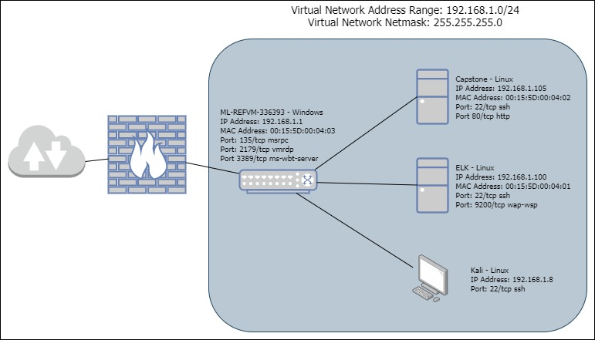
Network Topology
Network
Address Range: 192.168.1.0/24
Netmask: 255.255.255.0
Gateway: 192.168.1.1
Machines
IPv4: 192.168.1.1
OS: Microsoft
Hostname: ML-REFVM-336393
IPv4: 192.168.1.100
OS: Linux
Hostname: ELK
IPv4: 192.168.1.105
OS: Linux
Hostname: Capstone
IPv4: 192.168.1.8
OS: Linux
Hostname: Kali

Slide 5
Red Team
Security Assessment
5

Slide 6
Recon: Describing the Target
Nmap identified the following hosts on the network:
Hostname | IP Address | Role on Network
ML-REFVM-33639 | 192.168.1.1 | Switch/Gateway
Kali | 192.168.1.8 | Attack Computer
ELK | 192.168.1.100 | Network Monitor with
Capstone | 192.168.1.105 | Apache Web Server -Target Machine
Notes:
Network
Address Range: 192.168.1.0/24
Netmask: 255.255.255.0
Gateway: 192.168.1.1
Machines
IPv4: 192.168.1.1
OS: Microsoft
Hostname: ML-REFVM-336393
IPv4: 192.168.1.100
OS: Linux
Hostname: ELK
IPv4: 192.168.1.105
OS: Linux
Hostname: Capstone
IPv4: 192.168.1.8
OS: Linux
Hostname: Kali

Slide 7
Vulnerability Assessment
The assessment uncovered the following critical vulnerabilities in the target:
Vulnerability | Description | Impact
Sensitive Data Exposure | The sensitive data (/company_folders/sercret_folder and the /webdav were available to the public and accessible through a web browser | The public facing information revealed that ‘Ashton’ was the admin for the secret_folder
Security Misconfiguration | The servers had no alerts or limits for failed log on attempts – this allowed for easy access with a Brute-Force password exploit | Using the sensitive data we found on the public facing web page we were able to Brute-Force attack the login credentials to the /secret_folder. Inside that folder there was a password hash for ‘Ryan’ and instructions on how to upload a /webdav folder
Unrestricted File Upload | No restrictions for file uploads to the /webdav folder | We uploaded a reverse tcp script (shell.php) which allowed backdoor access and complete C2 of the Capstone web server

Slide 8
Exploitation: Sensitive Data Exposure
01
02
Tools & Processes
NMAP scan revealed IP address 192.168.1.105 had an open HTTP port 80.
Utilized Firefox web browser to locate and access company folders.
Achievements
Noted company file structure
Accessed the /company_folders/secret_folders and /meet_our_team folders
Determined that Ashton was the admin of the /company_folders/secret_folder

Slide 9
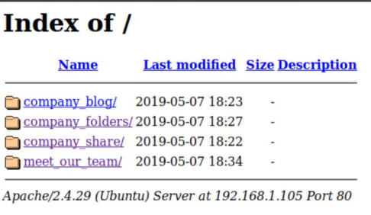
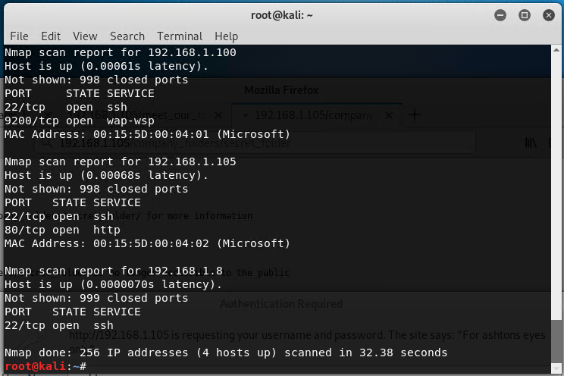
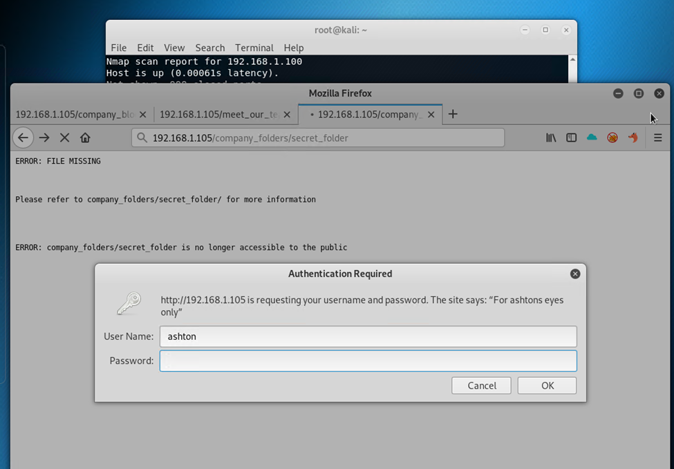
Exploitation: Sensitive Data Exposure
03

Slide 10
Exploitation: Security Misconfiguration
01
02
03
Tools & Processes
How did you exploit the vulnerability? Which tool (Nmap, etc.) or techniques (XSS, etc.) did you use?
Achievements
What did the exploit achieve? For example: Did it grant you a user shell, root access, etc.?
[INSERT: screenshot or command output illustrating the exploit.]

Slide 11
Exploitation: [Name of Third Vulnerability]
01
02
03
Tools & Processes
How did you exploit the vulnerability? Which tool (Nmap, etc.) or techniques (XSS, etc.) did you use?
Achievements
What did the exploit achieve? For example: Did it grant you a user shell, root access, etc.?
[INSERT: screenshot or command output illustrating the exploit.]

Slide 12

Blue Team
Log Analysis and Attack Characterization
12

Slide 13

Analysis: Identifying the Port Scan
Answer the following questions in bullet points under the screenshot if space allows. Otherwise, add the answers to speaker notes.
What time did the port scan occur?
How many packets were sent, and from which IP?
What indicates that this was a port scan?
[Insert Here]
Include a screenshot of Kibana logs depicting the port scan.

Slide 14
Analysis: Finding the Request for the Hidden Directory
Answer the following questions in bullet points under the screenshot if space allows. Otherwise, add the answers to speaker notes.
What time did the request occur? How many requests were made?
Which files were requested? What did they contain?
[Insert Here]
Include a screenshot of Kibana logs depicting the request for the hidden directory.

Slide 15
Analysis: Uncovering the Brute Force Attack
Answer the following questions in bullet points under the screenshot if space allows. Otherwise, add the answers to speaker notes.
How many requests were made in the attack?
How many requests had been made before the attacker discovered the password?
[Insert Here]
Include a screenshot of Kibana logs depicting the brute force attack.

Slide 16
Analysis: Finding the WebDAV Connection
Answer the following questions in bullet points under the screenshot if space allows. Otherwise, add the answers to speaker notes.
How many requests were made to this directory?
Which files were requested?
[Insert Here]
Add a screenshot of Kibana logs depicting the WebDAV connection.

Slide 17
Blue Team
Proposed Alarms and Mitigation Strategies
17

Slide 18
Mitigation: Blocking the Port Scan
What kind of alarm can be set to detect future port scans?
What threshold would you set to activate this alarm?
What configurations can be set on the host to mitigate port scans?
Describe the solution. If possible, provide required command lines.

Slide 19
Mitigation: Finding the Request for the Hidden Directory
What kind of alarm can be set to detect future unauthorized access?
What threshold would you set to activate this alarm?
What configuration can be set on the host to block unwanted access?
Describe the solution. If possible, provide required command lines.

Slide 20
Mitigation: Preventing Brute Force Attacks
What kind of alarm can be set to detect future brute force attacks?
What threshold would you set to activate this alarm?
What configuration can be set on the host to block brute force attacks?
Describe the solution. If possible, provide the required command line(s).

Slide 21
Mitigation: Detecting the WebDAV Connection
What kind of alarm can be set to detect future access to this directory?
What threshold would you set to activate this alarm?
What configuration can be set on the host to control access?
Describe the solution. If possible, provide the required command line(s).

Slide 22
Mitigation: Identifying Reverse Shell Uploads
What kind of alarm can be set to detect future file uploads?
What threshold would you set to activate this alarm?
What configuration can be set on the host to block file uploads?
Describe the solution. If possible, provide the required command line.

